Slide 1
How To Face An Interview? and How to use Soft Skills for Success in Interviews?
Dr. Ipsita Bhattacharyya

Slide 2
What is an Interview?
An interview is a conversation between two or more people where questions are asked by the interviewer to bring out facts or statements from the interviewee. It is used to analyse the candidates aspiring to join an organisation.
Analysis
Assessment Two main points to be
remembered

Slide 3
Be your natural self:
Do not try to be someone you are not. The interviewer is an expert of his job and will immediately catch hold of any dishonest statement or action you portray. Do not pretend to be someone you are not. Be as natural as possible without being nervous.
DON’T--- Overact or try to project a false image.

Slide 4
Dress appropriately:
Remember, you are going for an interview, not a fancy dress competition or party. Dress smartly and neatly. Do not wear a lot of jewellery. If ladies are wearing a saree, pin it properly. Do not walk in for the interview shabbily. Tuck your hair properly. Do not wear any uncomfortable dress. Wearing formals is always suitable for appearing in an interview.

Slide 5
Body language:
Most of the communication that we do during an interview is non-verbal. Body language plays an important part during an interview.
Some simple body language that you should use during a job interview are:
1. Sit straight and all the way back in your seat
2. Plant your feet on ground

Slide 6
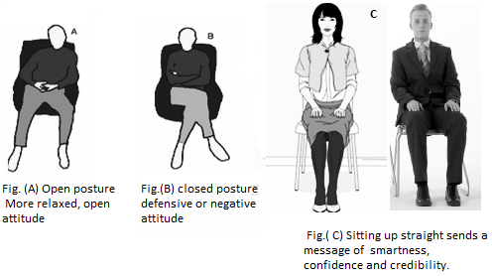

Slide 7
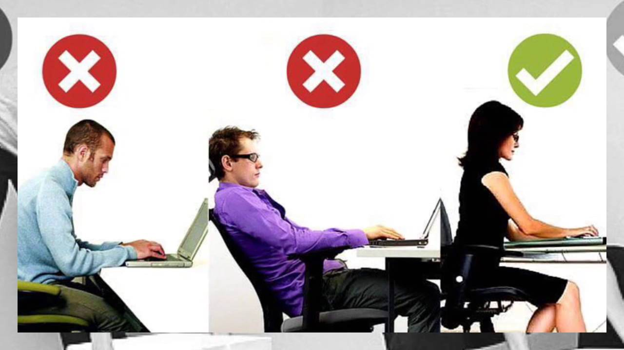

Slide 8

3. Use hand gestures while speaking.
4. Work on your walk
5. Smile and Nod your head while listening

Slide 9

Hand Gestures

Slide 10
Do not shake your legs or tap your feet in nervousness.
Do not fiddle with your hair or rub your hands. After all, the interviewer is also just another human being. He is sure to have some flaws too.

Slide 11
Know you CV, job and company:
Have a firm grasp on your CV, the job you're applying for and the company. Be specific about your achievements and your growth so far. Set examples of events that set you apart from others. Think of a reason why the interviewer should hire you. Give them a reason to choose you. Also, know the company well. You are required to work for them; therefore they expect you to be well-informed of the organisation, its products, services and industry as a whole

Slide 12
Soft Skills
Soft skills are a combination of people skills, social skills, communication skills, character skills, attitudes, career attribute, personal habits, cognitive or emotional empathy, time management, teamwork and leadership traits that help in working well with others, perform well, and achieve their goals while complementing hard skills.
It is through a 1972 US Army training manual identified formal usage of the term "soft skills" began.

Slide 13
Soft Skills vs Hard Skills
Hard skills are teachable abilities or skill sets that are easy to quantify. Typically, you'll learn hard skills in the classroom, through books or other training materials, or on the job. Examples of hard skills include: | Soft skills, on the other hand, are subjective skills that are much harder to quantify. Also known as "people skills" or “interpersonal skills”, soft skills relate to the way you relate to and interact with other people.

Slide 14
Examples of hard skills include: | Examples of soft skills include:
Proficiency in a foreign language A degree or certificate Typing speed Machine operation Computer programming Accounting software | Communication Leadership Patience Persuasion Problem Solving Abilities Teamwork Time Management

Slide 15
No matter the context is, there are a few soft skills that are highly sought after in an interview:
Positive attitude
Communication.
Teamwork.
Leadership.
Powers of Persuasion Critical thinking.
Work ethic.

Slide 16
Show Your Enthusiasm/Positive Attitude
It sounds obvious, but don’t suppress your enthusiasm and excitement about a role. Employers want a candidate who is genuinely interested in the organization and passionate about what they do. Put all your energy into your interviews and don’t give the impression you’re lackluster or ambivalent about the position.

Slide 17
First-rate Communication
An interview is a good opportunity for employers to assess your verbal communication style and ability to express your ideas. Before an interview, practice talking about your experience out loud. Try to keep answers clear, concise and to the point. Good communication also requires you to be an excellent listener, so always pay close attention to exactly what’s being asked of you.

Slide 18
Prove You're a Problem Solver
Potential employers look for lateral thinking and an innovative approach to tackling tricky situations. A natural problem solver who takes a creative approach to solving business issues is highly desirable to any employer. Make sure you think of tangible examples to highlight your skill at overcoming obstacles and generating successful outcomes.

Slide 19
Powers of Persuasion
Your ability to positively influence those around you is a critically important attribute. Do you negotiate effectively with different teams and individuals? Can you confidently build solid business relationships at all levels of an organization? Gather examples of how you have achieved this in the past.

Slide 20
Work ethic.
Make sure to think about how important the company's mission and vision are to you and explain why you're willing to go the extra mile to help the organization succeed. One tenet of evaluating candidates is that past performance is a predictor of future results. Make sure you prove that you have a strong work ethic by giving examples from the past about how you went above and beyond the call of duty to get a job done.

Slide 21
Time management
This is a crucial skill many employers seek in their hires. Earnest notes, "It's especially important for candidates who want to work in a startup to know how to manage their time, tasks and responsibilities effectively." Be prepared to explain how you prioritize the most important items first, delegate the items that others can do and figure out a way to get things done in the confines of your resources on the job.

Slide 22
Self confidence
You can demonstrate self confidence at the interview by the way you present yourself, including how you dress for the interview, the way you approach to shake hands and how you speak about your experiences during the interview.

Slide 23
Leadership: Lead a situation to achieve the desired goal.
Having leadership skills does not mean that you are a manager or the leader of something, it simply means that you have the ability to take charge of a situation and make sure that it gets resolved.
Teamwork: Ability to work with a team and adapt to different work environments and work behaviour.
Teamwork is an essential part of workplace success. When everyone in the workplace works together to accomplish goals, everyone achieves more. The ability to work as part of a team is one of the most important skills in today's job market.

Slide 24
Critical Thinking:
Critical thinking is a self-disciplined and self-guided action. Critical thinking requires the individual to use their own reasoning skills and have the ability to evaluate and reflect. One important thing to consider is that people who are critical thinkers commonly are also more empathetic and aware of their world.

Slide 25

Thank You

